Slide 1
BIMDAS
Year 7
Week 6
Lesson 1

Slide 2
We are setting up a NEW section of your interactive notebooks for the next topic!
From your last page of the previous notebook skip one page and we will set up the new notebook.
You will have the page numbers start over again!

Slide 3
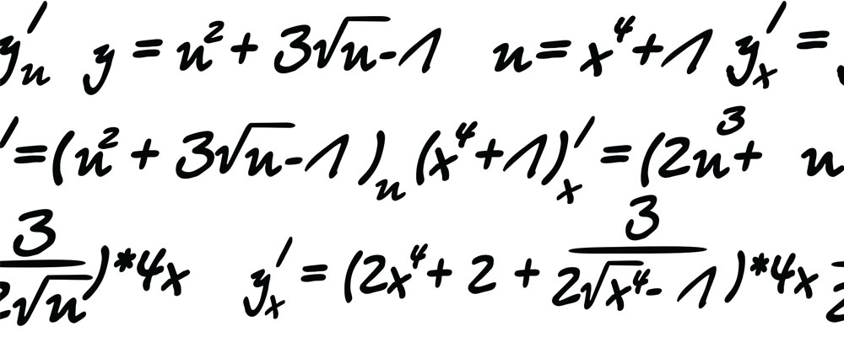

My Algebra
Interactive Notebook
Name:
Class: 7 - 2
Teacher: Miss L
Term 2 Semester 1

Slide 4
Contents
Glossary or Formula Page
Page
Date
Description
2
3

Slide 5
Last Lesson Recap
Notes:
• Share with students what they are learning or will be able to do
• Why the lesson is important

Slide 6
Lesson Objective
By the end of the lesson I will:
Know how to use BIMDAS to help work out equations

Slide 7
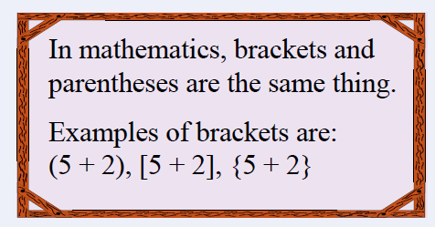
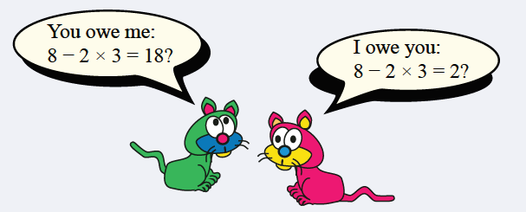
24
7
30
Topic: Order of Operations
Date
EQ – How do you use BIMDAS to work out equations?
BIMDAS is the order in which you work out the equation:
B – Brackets ( )
I – Indices 5³
M – Multiplication x
D – Division ÷
A – Addition +
S – Subtraction -
What does BIMDAS stand for?
Which cat is correct??

Slide 8

Examples
$$\left(8−5\right)×3$$
$=3×3$
$$=$$
Notes:
• Give students the opportunity to practise with teacher guidance
• Provide immediate and specific feedback with knowledge of results

Slide 9
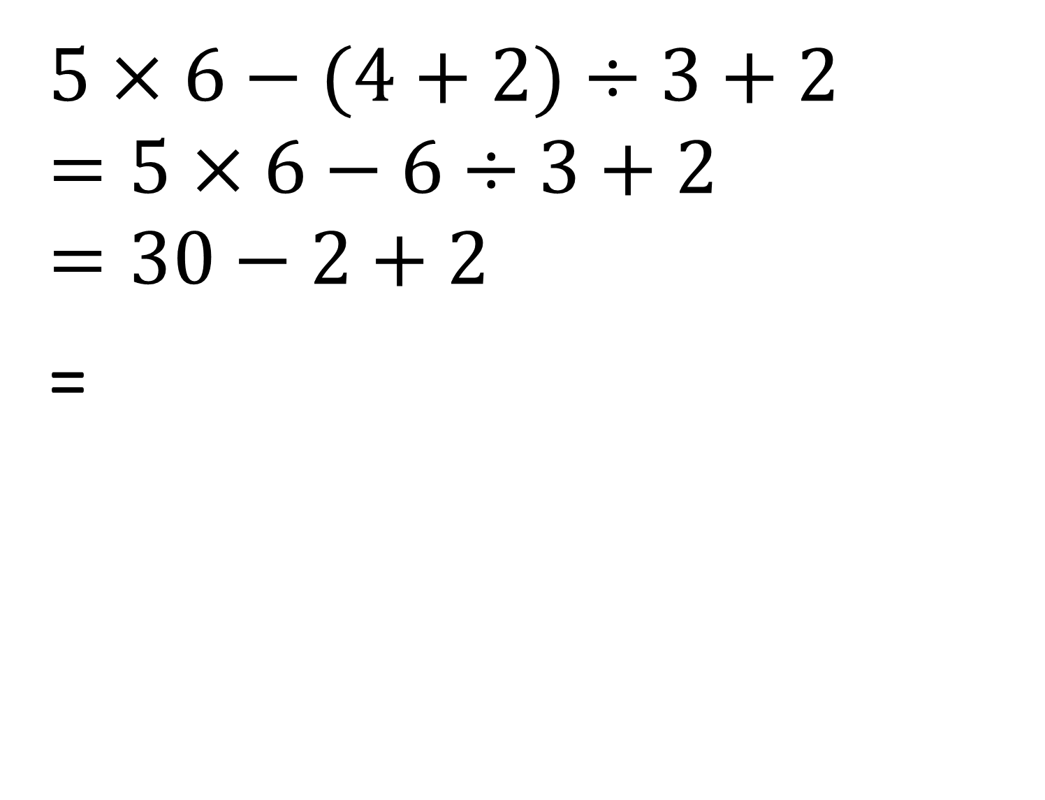
Examples
$$5×6−(4+2)÷3+2=5×6−6÷3+2=30−2+2$$
=
Notes:
• Give students the opportunity to practise with teacher guidance
• Provide immediate and specific feedback with knowledge of results

Slide 10
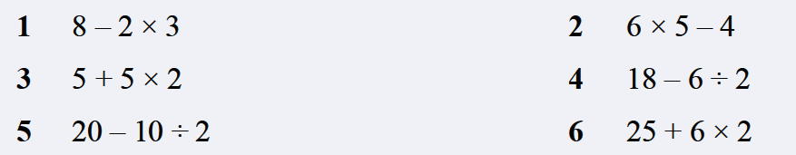
Task
Notes:
• Give students the opportunity to practise with teacher guidance
• Provide immediate and specific feedback with knowledge of results

Slide 11

Task
Notes:
• Give students the opportunity to practise with teacher guidance
• Provide immediate and specific feedback with knowledge of results

Slide 12
Exit Ticket
Complete the Exit Ticket and give to me at the door when you leave

